Slide 1
DBSCAN - (Density-Based Spatial Clustering of Applications with Noise)

Slide 2
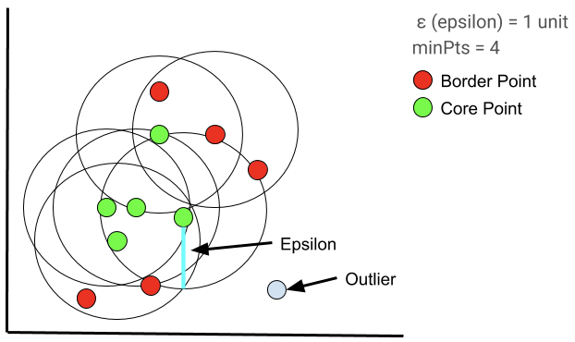
Groups all the points that are closely packed (high density) while marking points in low-density areas as noise.

Slide 3
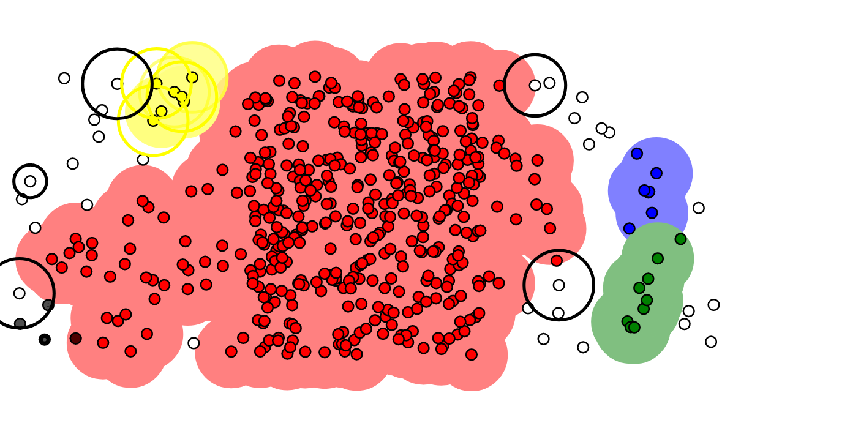
Step 1 — Identify all points as either core point, border point or noise point.
Step 2 — For all of the unclustered core points.
Step 2a — Create a new cluster.
Step 2b — add all the points that are unclustered and density connected to the current point into this cluster.

Slide 4
When to use DBSCAN?
DBSCAN is used when the data has irregular shapes or when there is no prior knowledge about the number of clusters.

Slide 5
Strengths Weakness
Can detect noise and outliers, finds arbitrary-shaped clusters.
Requires careful tuning of parameters like eps(distance) & min_samples

Slide 6

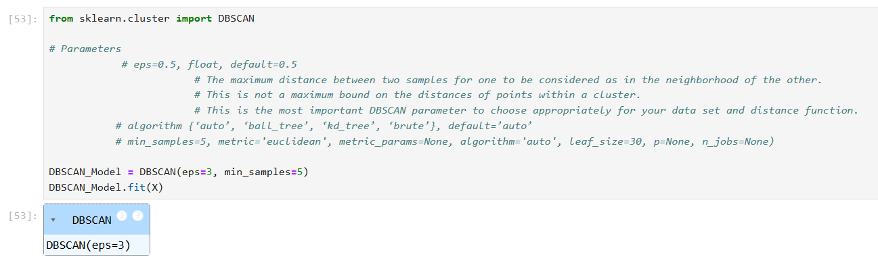
Model Creation

Slide 7
Priyadharshini Manikandan

